Slide 1
Levels and Trends of Adult Mortality in Sub-Saharan Africa
Ayaga A. Bawah, PhD
Regional Institute for Population Studies (RIPS)
University of Ghana, Accra, Ghana
Presentation prepared for
Africa Mortality Symposium
30th November 2022

Slide 2
Outline
Introduction
Data and methods
Results – trends and patterns of adult mortality
Discussion
Conclusions

Slide 3
Introduction
Adult mortality has not received much attention compared to child mortality
Yet significant number of premature deaths among adults are reported
Partly due to paucity of data on health and survival
In the 1970s through much of the 80s methodological innovations were developed to indirectly estimate adult mortality using census and survey data
Methods like Sibling History/Sisterhood, two census methods such as death distribution methods, among many were developed
Questions were added to censuses and Demographic and Health Surveys (DHS) in various countries to capture data to estimate adult mortality
But the reliability of these data has often been questioned

Slide 4
Data and Methods
Data from selected Health and Demographic Surveillance Systems (HDSS) sites in Africa to show levels and trends of adult mortality
HDSSs are community-based localized studies that collect data on populations and their attributes – fertility, mortality, migrations and related household and individual characteristics over time
Some of these sites have operated for a very long time and thus have data to study long-terms trends

Slide 5
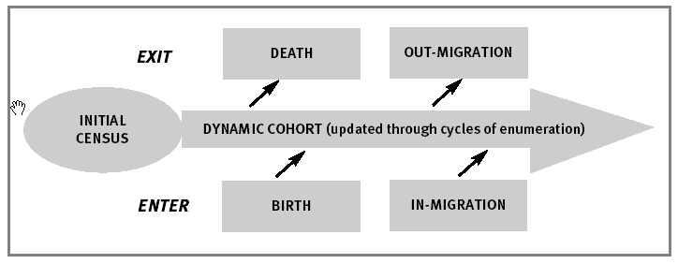
Methodological Approach of HDSS
Intervention trials (randomised)
Capturing episodes of disease and hospital admission
Verbal autopsy for cause of death
Measure characteristics of environment or household members (e.g. SES, vaccines, HIV, nutrition)
Notes:
5

Slide 6
Adult Mortality: Probability of Dying between 15 and 60 Years of Age

Slide 7
Results
I present results using both HDSS and DHS data for selected settings/countries

Slide 8
Trends in Adult Mortality rates per 1,000 person years for Adults 15 + years, Navrongo HDSS: 1996-2019

Slide 9
Trends Maternal Mortality at Ifakara Rural/Urban HDSS and Rufiji HDSS Site, Tanzania
Source: Data from Ifakara and Rufiji HDSS, Tanzania

Slide 10
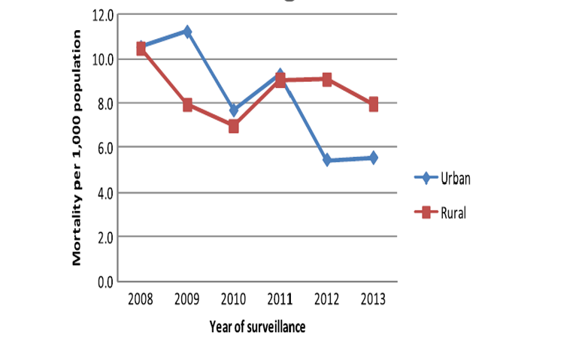
Adult mortality rates by place of residence Kersa HDSS 2008–2013
Source: Ashenafi et al. 2017. Population Health Metrics

Slide 11
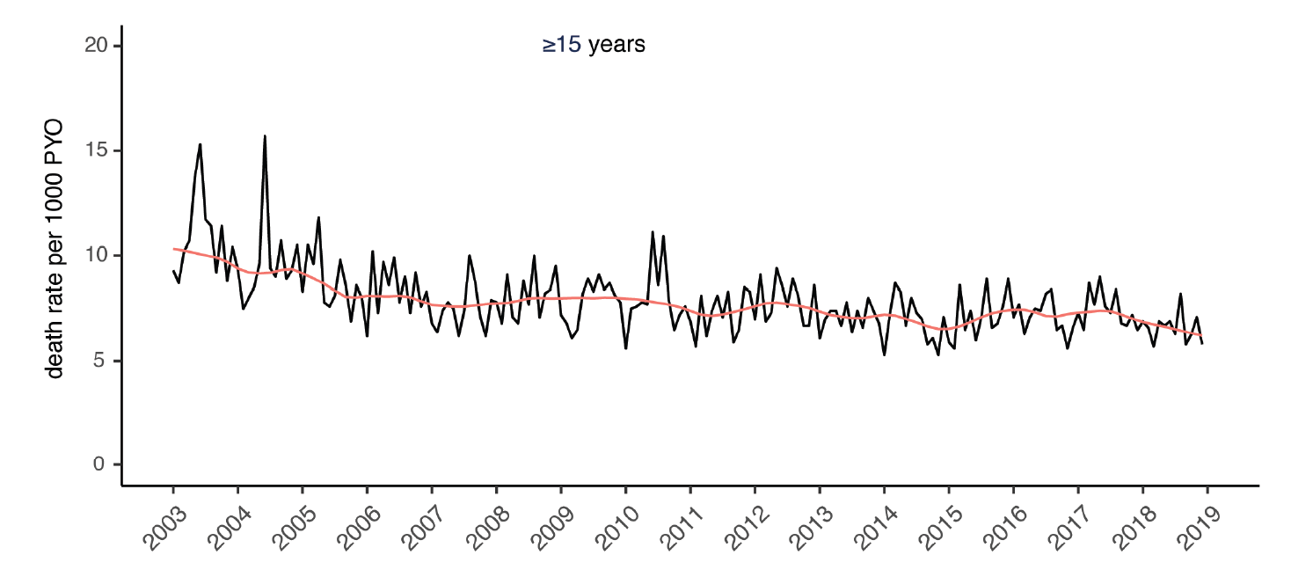
Monthly Mortality Rates for Adults 15 + from Kilifi HDSS, Rural Coastal Kenya
Source: Otiende et al. 2021. Wellcome Open Research

Slide 12
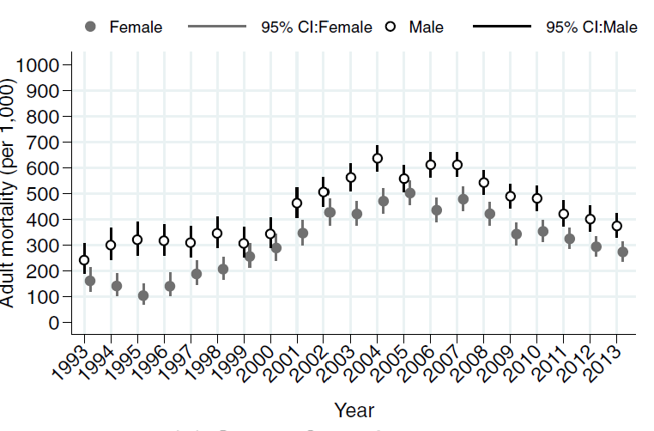
Trends in Adult Mortality Rates by Sex, Rural South Africa, Agincourt HDSS 1993-2013
Source: Kabudula et al. 2017. BMC Public Health

Slide 13
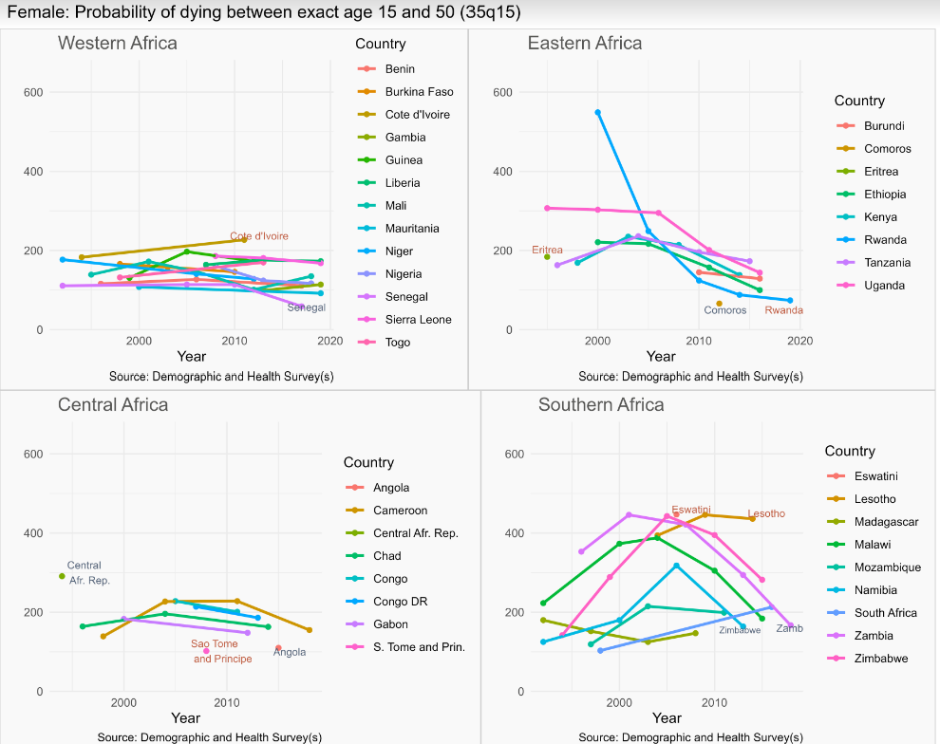
Female Probabilities of Dying between Exact Age 15 and 50 (35q15)

Slide 14
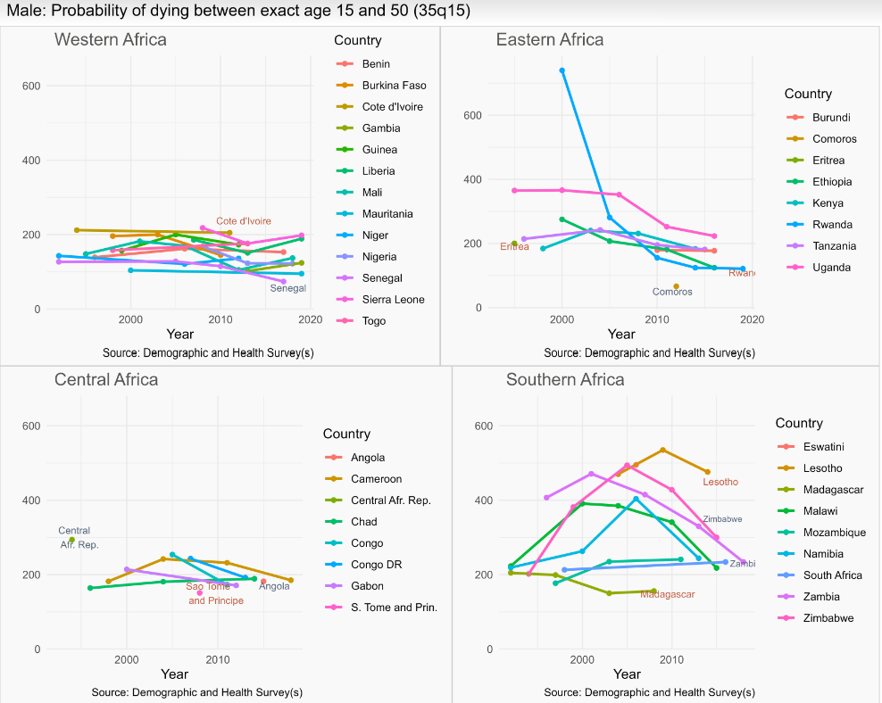
Male Probabilities of Dying between Exact Age 15 and 50 (35q15)

Slide 15
Discussion
Data from the HDSS show that adult mortality has been declining
Nevertheless, adult mortality remains high
Results from Agincourt HDSS site in rural South Africa showed the impact of HIV on adult mortality
Similarly, DHS data showed that while adult mortality is declining, it still remains high
HDSS data provide opportunities for monitoring progress of interventions at the local/community level
Further research is needed to get more understanding of adult mortality in SSA

Slide 16
Conclusions
Adult mortality rates, as reflected in both general adult mortality figures, as well as the maternal mortality rates, remain high but on the decline
However, levels vary across HDSS sites and sub-regions
Data still scarce on adult mortality in SSA so there is need to invest in generating evidence on trends and patterns in adult mortality

Slide 17
Thank you for your attention Email: aabawah@ug.edu.gh

